Slide 1

Learning Hand-Eye Coordination for Robotic Grasping with Deep Learning and Large-Scale Data Collection
Author:
Sergey Levine SLEVINE @ GOOGLE . COM
Peter Pastor PETERPASTOR @ GOOGLE . COM
Alex Krizhevsky AKRIZHEVSKY @ GOOGLE . COM
Deirdre Quillen DEQUILLEN @ GOOGLE . COM
Google

Slide 2
Contents：
1. Introduction
2. Target
3. Method
4. Data collection
5. Result
6. Discussion

Slide 3
1. Introduction
Target
Method
Data collection
Result

Slide 4
1. Introduction
Target
Describe a learning-based approach to hand-eye coordination for robotic grasping from monocular images.
Method
we trained a large convolutional neural network to predict the probability that task-space motion of the gripper will result in successful grasps
use only monocular camera images and independently of camera calibration or the current robot pose.
use this network to servo the gripper in real time to achieve successful grasps.

Slide 5
1. Introduction
Data collection
over 800,000 grasp attempts
using between 6 and 14 robotic manipulators
differences in camera placement and hardware
Result
method achieves effective real-time control
successfully grasp novel objects
correct mistakes by continuous servoing

Slide 6
2. Target
We propose a learning-based approach to hand-eye coordination, which we demonstrate on a robotic grasping task.
data-driven
Our method learns to servo a robotic gripper to poses that are likely to produce successful grasps, with end-to-end training directly from image pixels to task-space gripper motion.
goal-centric
By continuously recomputing the most promising motor commands, our method continuously integrates sensory cues from the environment, allowing it to react to perturbations and adjust the grasp to maximize the probability of success.

Slide 7
3. Method
grasp success predictor
It uses a deep convolutional neural network (CNN) to determine how likely a given motion is to produce a successful grasp.
continuous servoing mechanism
It uses the CNN to continuously update the robot’s motor commands. By continuously choosing the best predicted path to a successful grasp, the servoing mechanism provides the robot with fast feedback to perturbations and object motion, as well as robustness to inaccurate actuation.

Slide 8
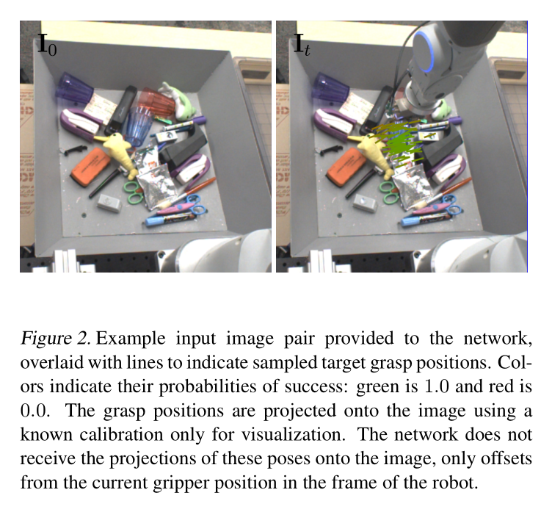
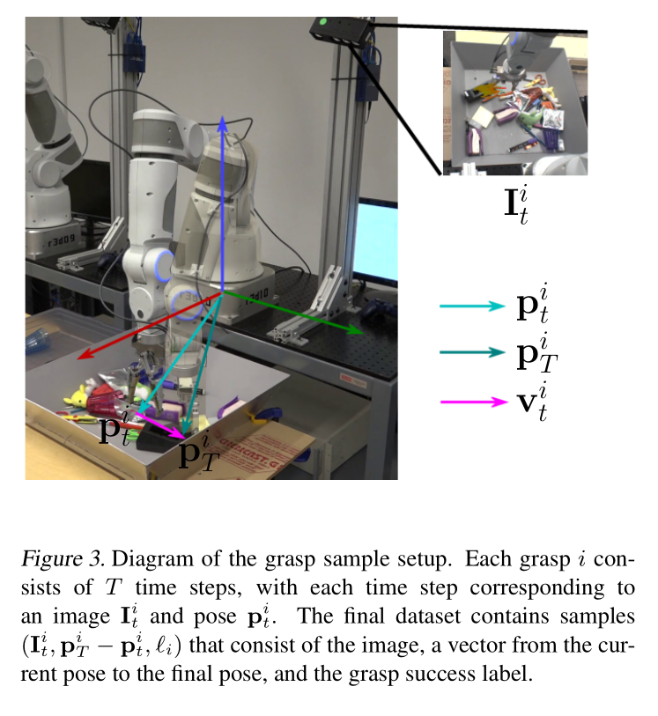
3.1 Grasp Success Prediction with CNN

Slide 9
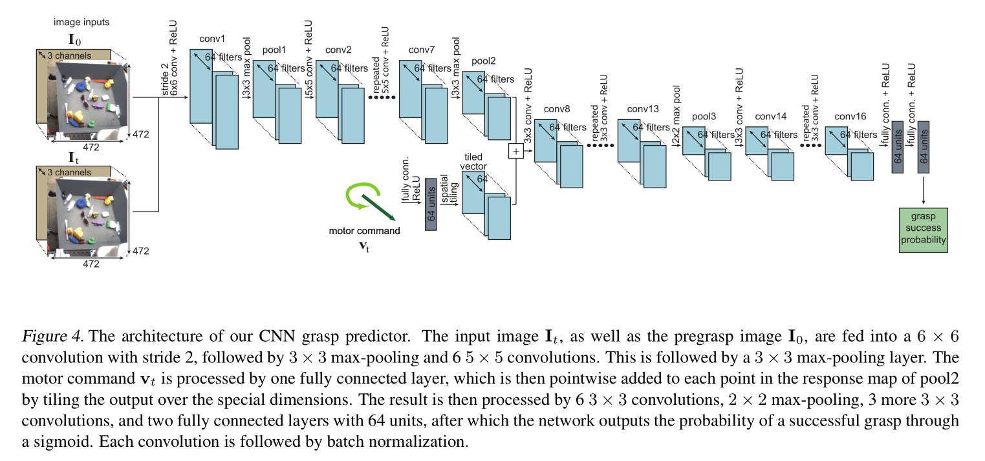
3.1 Grasp Success Prediction with CNN

Slide 10
3.2 Continuous Servoing Mechanism
Visual servoing
Also known as vision-based robot control
Visual servoing uses feedback information extracted from a vision sensor (visual feedback) to control the motion of a robot
Relations between end-effector (hand) and the camera
Eye-in-hand, or end-point closed-loop control, where the camera is attached to the moving hand and observing the relative position of the target.
Eye-to-hand, or end-point open-loop control, where the camera is fixed in the world and observing the target and the motion of the hand.

Slide 11
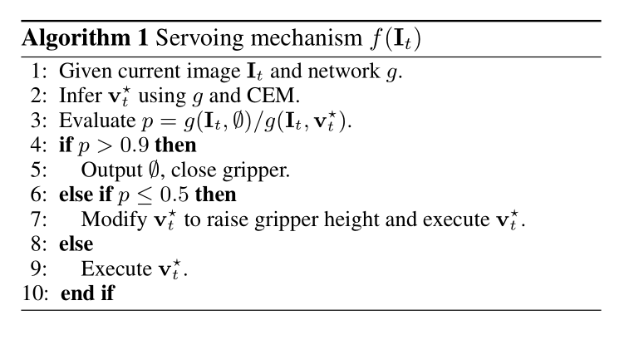
3.2 Continuous Servoing Mechanism
Two heuristics
Stop the grasp early if closing the gripper is nearly as likely to produce a successful grasp as moving it.
If closing the gripper now is substantially worse than moving it, the gripper is most likely not positioned in a good configuration, and a large motion will be required. Therefore, raising the gripper off the table minimizes the chance of hitting other objects that are in the way.

Slide 12
4. Data collection
Setup
over 800,000 grasp attempts
using between 6 and 14 robotic manipulators
differences in camera placement and hardware

Slide 13
4. Data collection
Objects for grasping
chosen among common household and office items
ranged from a 4 to 20 cm in length along the longest axis
Grasp success evaluation
the position reading on the gripper was greater than 1 cm
the images before and after the drop are different

Slide 14
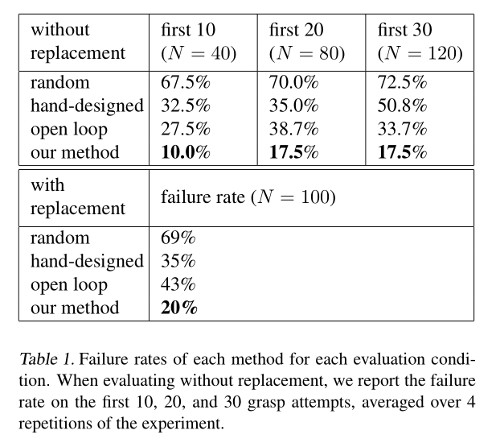
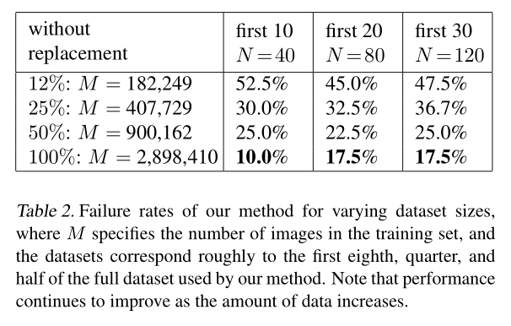
5. Result

Slide 15
6. Discussion
Main contributions
A novel convolutional neural network architecture for learning to predict the outcome of a grasp attempt
A method for learning continuous visual servoing for robotic grasping from monocular cameras
A large-scale data collection framework for robotic grasps

Slide 16
Thank you for listening!

